Slide 1


Automation for IBM
Ansible Technical Introduction and Overview
Shadd Gallegos

Slide 2

Wenger 16999 Metaphor

Slide 3
WHAT CAN I DO WITH ANSIBLE?
Automate the deployment and management of your entire IT footprint.
Do this...
Orchestration
Configuration Management
Application Deployment
Provisioning
Continuous Delivery
Security and Compliance
On these...
Firewalls
Load Balancers
Applications
Containers
Clouds
Servers
Infrastructure
Storage
Network Devices
And more...

Slide 4
ANSIBLE SHIPS WITH OVER 2000 MODULES
CLOUD
VIRT AND CONTAINER
WINDOWS
NETWORK
NOTIFY
AWS
Azure
CenturyLink
CloudScale
Digital Ocean
Docker
Google
Linode
OpenStack
Rackspace
And more...
Docker
VMware
RHEV
OpenStack
OpenShift
Atomic
CloudStack
And more...
ACLs
Files
Commands
Packages
IIS
Regedits
Shell
Shares
Services
DSC
Users
Domains
And more...
Arista
A10
Cumulus
Big Switch
Cisco
Cumulus
Dell
F5
Juniper
Palo Alto
OpenSwitch
And more...
HipChat
IRC
Jabber
Email
RocketChat
Sendgrid
Slack
Twilio
And more...

Slide 5
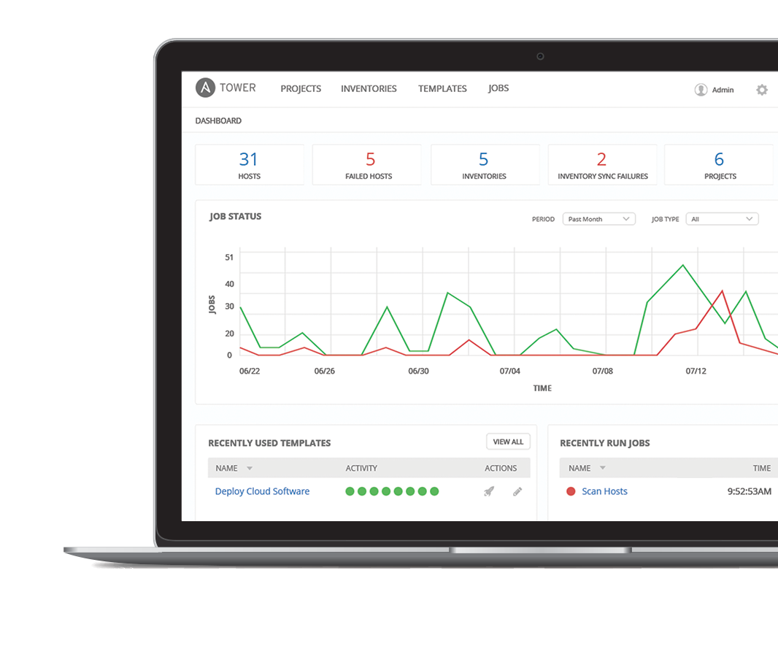
WHAT IS ANSIBLE AUTOMATION?
Ansible Engine is a simple tool that allows engineers, administrators, and operators to automate activities they are responsible for today. It is a workforce multiplier.
Ansible Tower is an enterprise framework for controlling, securing, managing and extending your Ansible Automation with a UI and RESTful API. It is an automation platform.
Ansible Automation provides the glue needed to bridge together all layers of an enterprise architecture.
Notes:
Ansible Engine is an automation tool for the individual engineer.
Ansible Tower is the platform/framework that multiple engineers/teams use to collaborate and bridge together their automation in workflows.
Ansible Automation provides

Slide 6


RED HAT ANSIBLE TOWER
Scale + operationalize your automation
CONTROL
KNOWLEDGE
DELEGATION
RED HAT ANSIBLE ENGINE
Support for your Ansible automation
SIMPLE
POWERFUL
AGENTLESS
FUELED BY AN INNOVATIVE OPEN SOURCE COMMUNITY
Notes:
Control: scheduled and centralized jobs
Knowledge: Visibility and compliance
Delegation: Role-based access and self service
Simple: Everyone speaks the same language
Powerful: Designed for multi-tier deployments
Agentless: Predictable, reliable and secure

Slide 7










HOW ANSIBLE WORKS
CMDB
CMDB
CMDB
CMDB
CMDB
CMDB
PUBLIC / PRIVATE CLOUD
PUBLIC / PRIVATE CLOUD
PUBLIC / PRIVATE CLOUD
PUBLIC / PRIVATE CLOUD
PUBLIC / PRIVATE CLOUD
PUBLIC / PRIVATE CLOUD
PUBLIC / PRIVATE CLOUD
PUBLIC / PRIVATE CLOUD
PUBLIC / PRIVATE CLOUD
PUBLIC / PRIVATE CLOUD
PUBLIC / PRIVATE CLOUD
PUBLIC / PRIVATE CLOUD
CLOUD
OpenStack, VMware, EC2, Rackspace, GCE, Azure, Spacewalk, Hanlon, Cobbler
CUSTOM CMDB
PLUGINS
• Gears in the engine • Python that plugs into the core engine
• Adaptability for various uses & platforms
ANSIBLE’S AUTOMATION ENGINE
ANSIBLE’S AUTOMATION ENGINE
ANSIBLE’S AUTOMATION ENGINE
ANSIBLE’S AUTOMATION ENGINE
ANSIBLE’S AUTOMATION ENGINE
ANSIBLE’S AUTOMATION ENGINE
MODULES
• Tools in the toolkit
• Python, Powershell or any language
• Extend Ansible simplicity to entire stack
[web] webserver1.example.com webserver2.example.com
[db] dbserver1.example.com
PLAYBOOKS
• Written in YAML
• Tasks are executed sequentially
• Invokes Ansible modules
USERS
USERS
USERS
USERS
USERS
USERS
HOSTS
HOSTS
HOSTS
HOSTS
HOSTS
INVENTORY
HOSTS
INVENTORY
INVENTORY
INVENTORY
INVENTORY
INVENTORY
API
API
API
API
API
API
MODULES
MODULES
MODULES
MODULES
MODULES
MODULES
PLUGINS
PLUGINS
PLUGINS
PLUGINS
PLUGINS
PLUGINS
NETWORK DEVICES
NETWORK DEVICES
NETWORK DEVICES
NETWORK DEVICES
NETWORK DEVICES
NETWORK DEVICES
ANSIBLE PLAYBOOK
ANSIBLE PLAYBOOK
ANSIBLE PLAYBOOK
ANSIBLE PLAYBOOK
ANSIBLE PLAYBOOK
ANSIBLE PLAYBOOK

Slide 8
PLAYBOOK EXAMPLE
---
- name: install and start apache
hosts: web
become: yes
vars:
http_port: 80
tasks:
- name: httpd package is present
yum:
name: httpd
state: latest
- name: latest index.html file is present
copy:
src: files/index.html
dest: /var/www/html/
- name: httpd is started
service:
name: httpd
state: started
---
- name: install and start apache
hosts: web
become: yes
vars:
http_port: 80
tasks:
- name: httpd package is present
yum:
name: httpd
state: latest
- name: latest index.html file is present
copy:
src: files/index.html
dest: /var/www/html/
- name: httpd is started
service:
name: httpd
state: started
---
- name: install and start apache
hosts: web
become: yes
vars:
http_port: 80
tasks:
- name: httpd package is present
yum:
name: httpd
state: latest
- name: latest index.html file is present
copy:
src: files/index.html
dest: /var/www/html/
- name: httpd is started
service:
name: httpd
state: started
---
- name: install and start apache
hosts: web
become: yes
vars:
http_port: 80
tasks:
- name: httpd package is present
yum:
name: httpd
state: latest
- name: latest index.html file is present
copy:
src: files/index.html
dest: /var/www/html/
- name: httpd is started
service:
name: httpd
state: started
---
- name: install and start apache
hosts: web
become: yes
vars:
http_port: 80
tasks:
- name: httpd package is present
yum:
name: httpd
state: latest
- name: latest index.html file is present
copy:
src: files/index.html
dest: /var/www/html/
- name: httpd is started
service:
name: httpd
state: started
---
- name: install and start apache
hosts: web
become: yes
vars:
http_port: 80
tasks:
- name: httpd package is present
yum:
name: httpd
state: latest
- name: latest index.html file is present
copy:
src: files/index.html
dest: /var/www/html/
- name: httpd is started
service:
name: httpd
state: started
Notes:
Playbook example:
The name fields are human-readable comments. Optional, but useful as comments to the Playbook. These strings also show up in Tower, so it is easy to correlate any failures in a long running Playbook.
Inventory call-out
Variables can be handled in several different ways:
Directly in the playbook
As part of a separate vars file
Via the command line
As output from a previous play
Via Tower
You are not required to use root as the remote user. You can have Ansible connect and run the playbook as any user or even multiple users – as long as that user has the permission to perform the tasks in the playbook. You can even use multiple users and specify different users for different plays or tasks.
Ansible supports sudo, su, powerbroker, and other privilege escalation mechanisms.
The real work. General format:
<<module>>: key=value

Slide 9
Anatomy of a Playbook
- hosts: network
vars:
site_domain_name: 'example.net'
network_name_servers:
- 8.8.8.8
- 8.8.4.4
log_host: 10.2.2.3
tasks:
- name: Configure the hostname and domain name
net_system:
hostname: "{{ inventory_hostname }}"
domain_name: "{{ site_domain_name }}"
name_servers: "{{ network_name_servers }}"
- name: configure host logging
net_logging:
dest: host
name: "{{ log_host }}"
Inventory: The devices to configure
Variables: The key/value pairs that change from device to device
Tasks: The tasks to perform on those devices
1
Notes:
1

Slide 10
Declarative Intent
- name: configure interface
net_interface:
name: GigabitEthernet0/2
description: public interface configuration
enabled: yes
state: connected
neighbors:
- host: core-01
port: Ethernet5/2/6
Declared Configuration
Intended State
1
Notes:
1

Slide 11
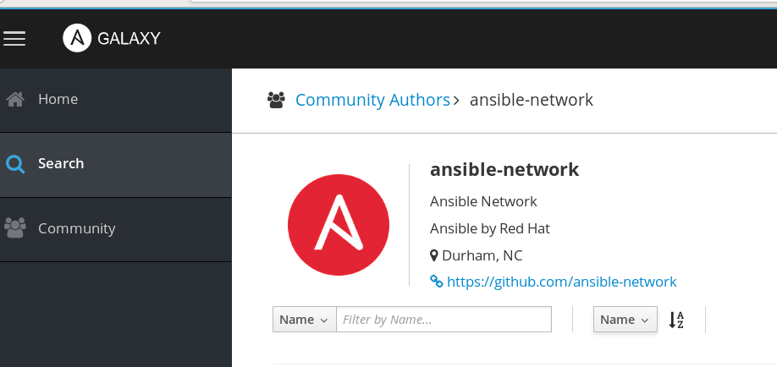
Ansible Networking Roles
{% for vlan in vlans %}
vlan {{ vlan.id }}
name {{ vlan.name }}
{% endfor %}
1

Slide 12
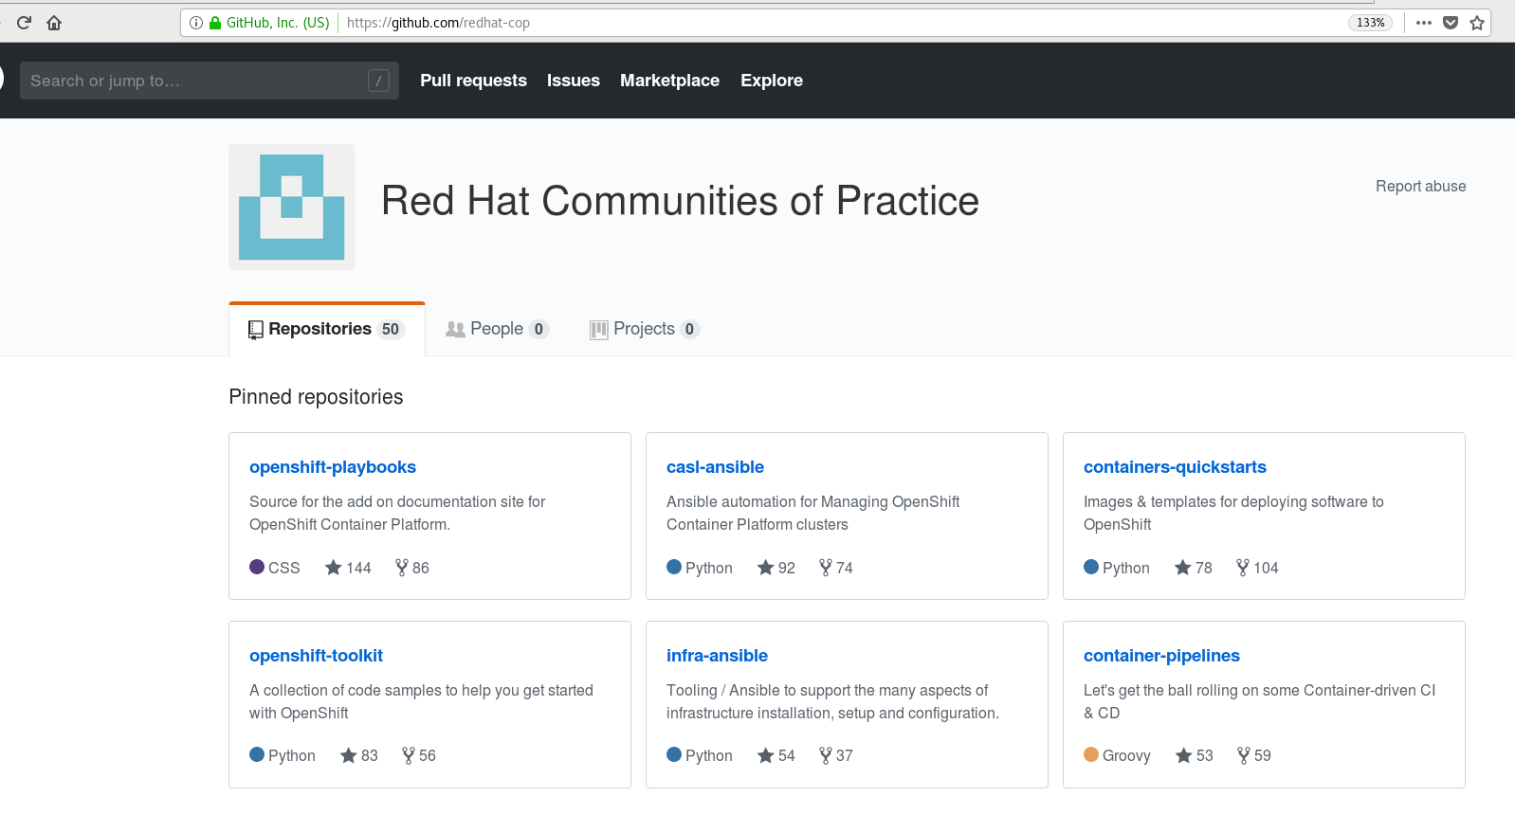
Red Hat Community of Practice
1

Slide 13
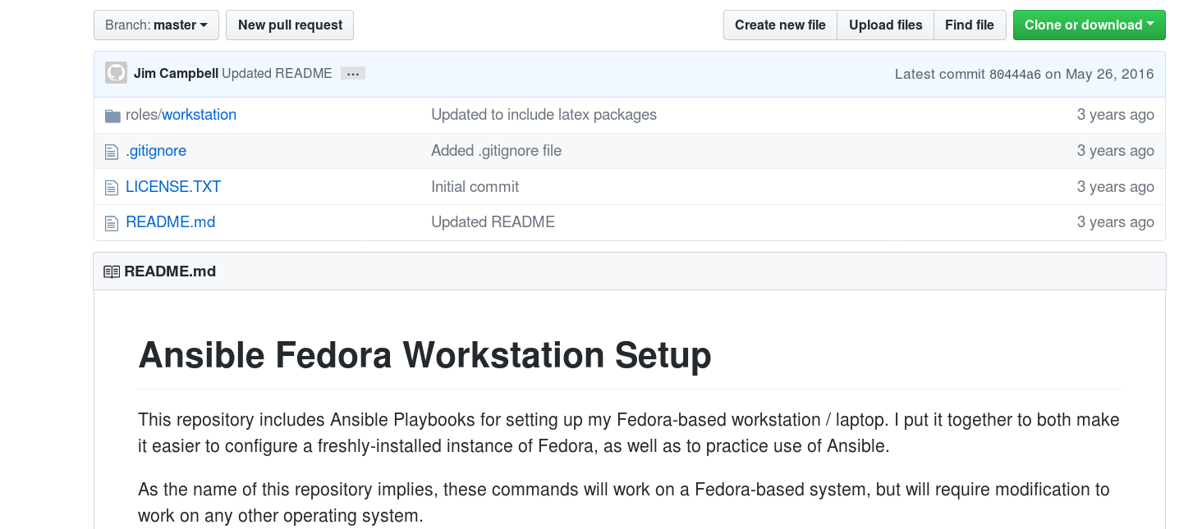
Small Automations can be Big Victories
https://github.com/j1mc/ansible-fedora-workstation-setup/tree/master/roles/workstation
1

Slide 14
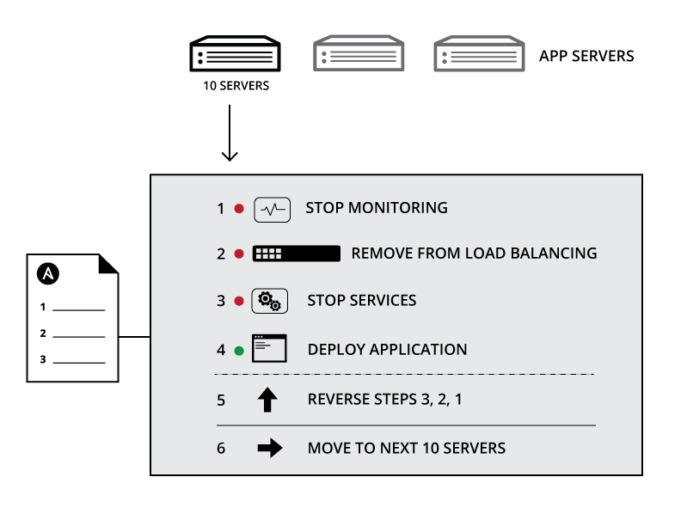
WHY IS AUTOMATION IMPORTANT?
Your applications and systems are more than just collections of configurations. They’re a finely tuned and ordered list of tasks and processes that result in your working application.
Ansible can do it all:
• Network
• Provisioning
• App Deployment
• Configuration Management
• Multi-tier Orchestration
Notes:
Combination of configuration and order
Configuration Management alone is not sufficient for app deployment
Allows you to automate entire sets of process

Slide 15

ANSIBLE
THE LANGUAGE OF DEVOPS

Slide 16
Convert Procedures to Playbooks
Create VLAN
Add port to VLAN
Address Interface
Method of Procedure
Playbook
Define Intent, Policy, Architecture
Apply across device type, vendor

Slide 17
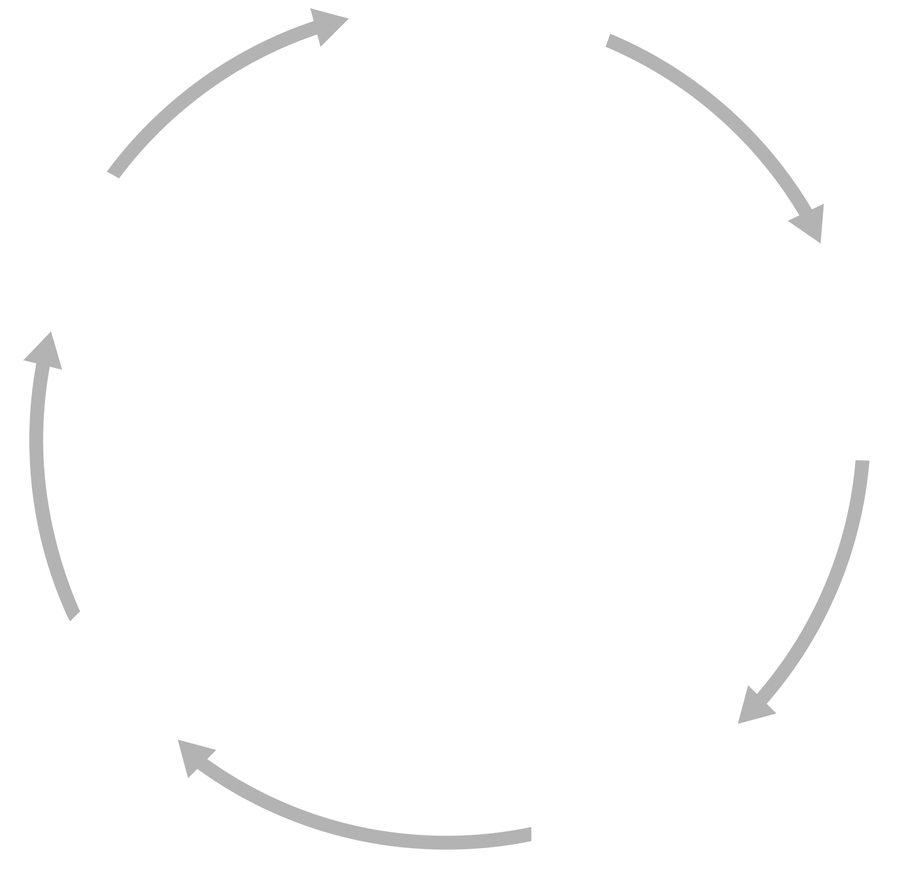

Manage Lifecycle with Process & Playbooks
OPERATE
DEVELOP
PLAN
SOURCE CONTROL
TEST
DESIGN
Revision control, configuration management
Ensure an ongoing steady-state
Automated testing, reduce human error

Slide 18






Communicate with Playbooks
DEVELOPMENT
SECURITY
OPERATIONS
BUSINESS
(ARCHITECTS)

Slide 19








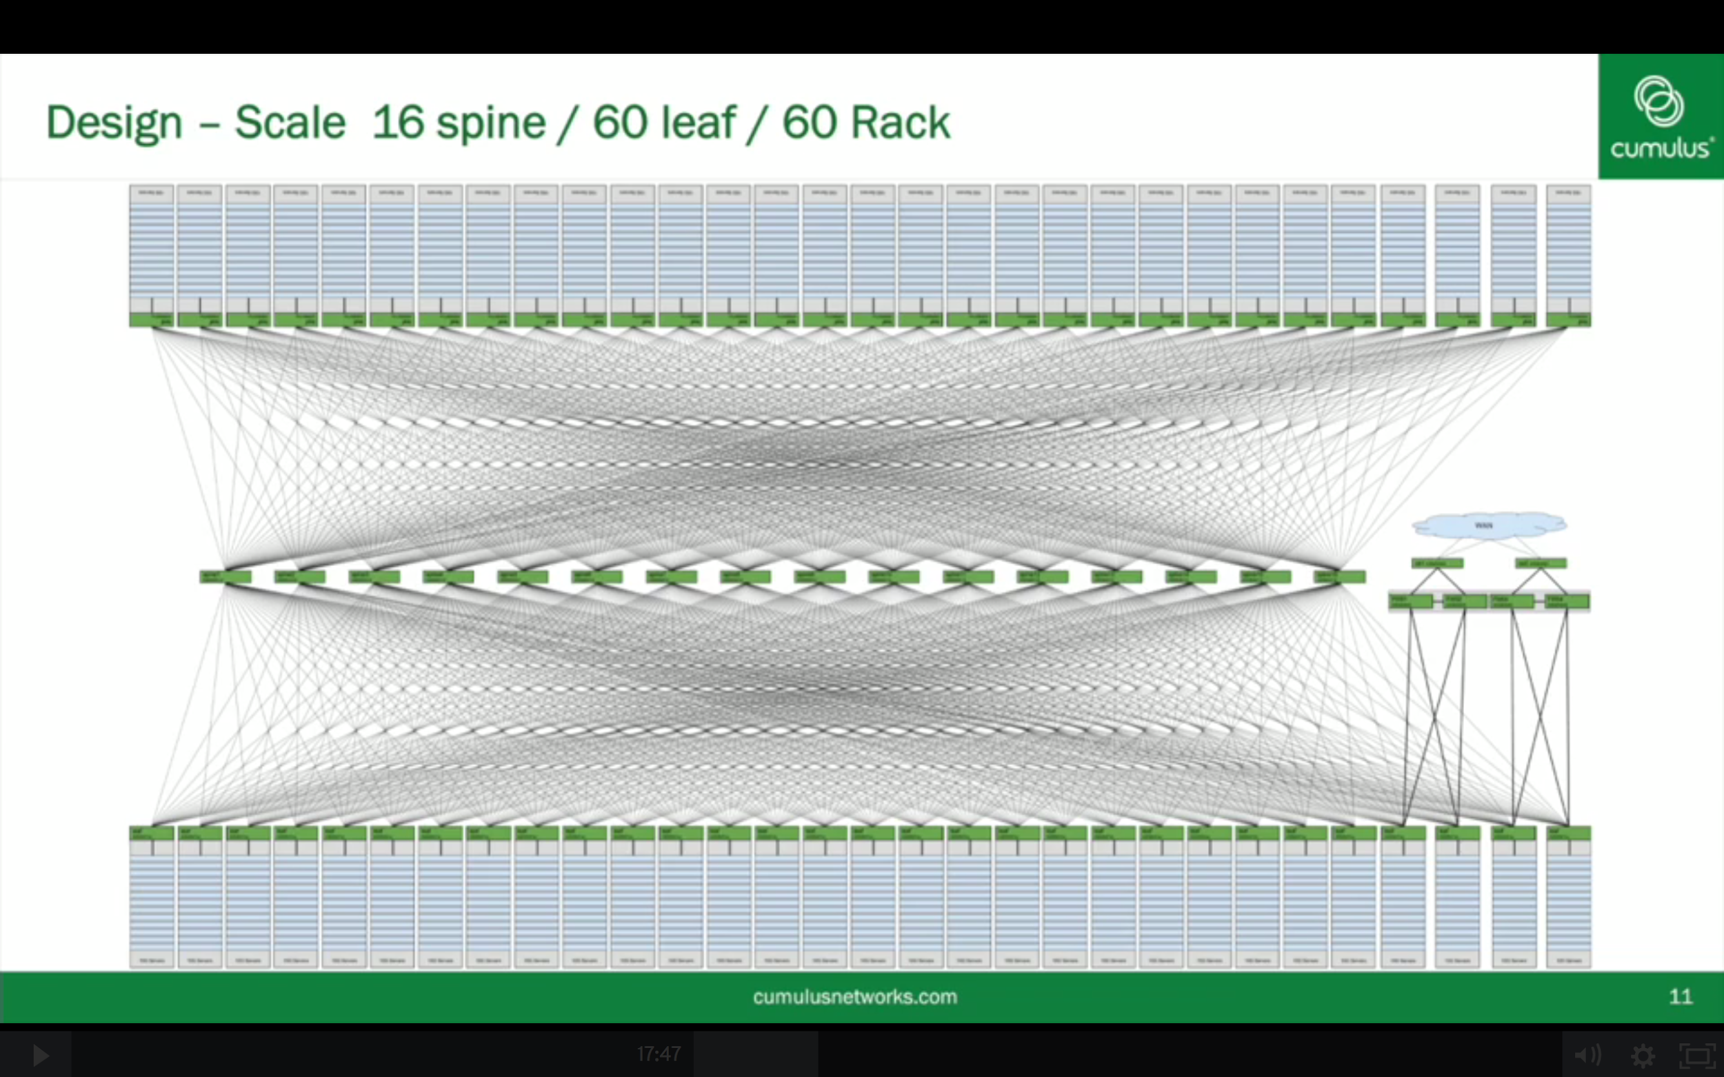

The Flexibility of Choice
Business Requirements
Abstraction Through Automation
BGP
LB
OSPF
VLAN
ACL
QOS
EVPN
AAA
Notes:
Not in the datapath
Network is not control-plane dependent
Not intrusive, do not imply network hw/sw upgrade

Slide 20


AUTOMATION FOR TEAMS
Ansible Tower technical introduction and overview

Slide 21

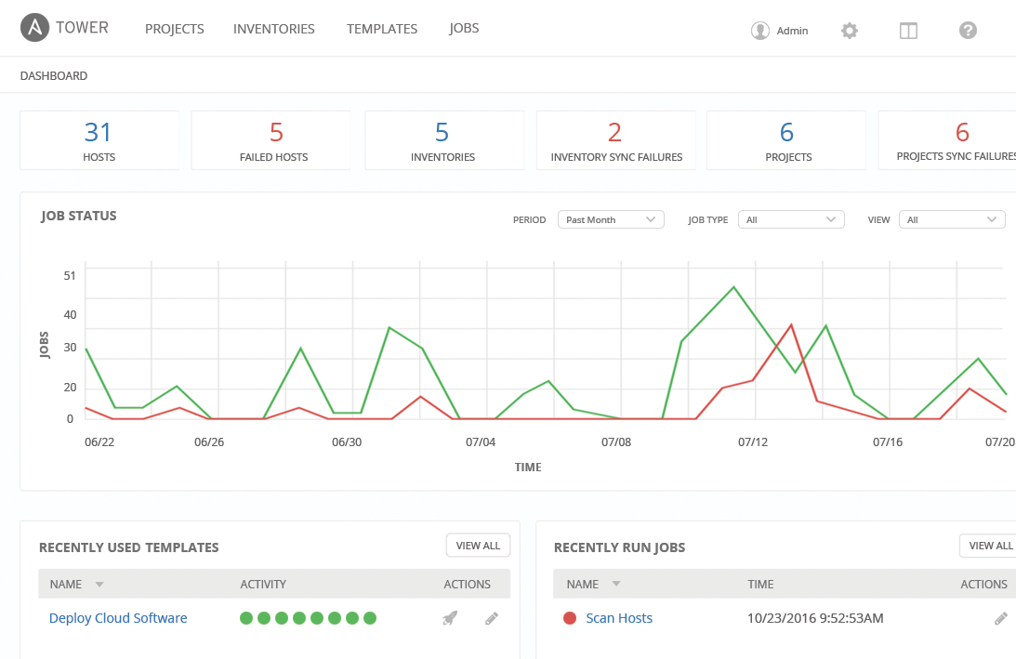
WHAT IS ANSIBLE TOWER?
Ansible Tower is an enterprise framework for controlling, securing and managing your Ansible automation – with a UI and RESTful API.
• Secure credential storage
• Role-based access control
• Launch Playbooks with the click of a button
• Create workflows composed of multiple Playbooks
• All automations are centrally logged
Notes:
Control, Knowledge, Delegation
RBAC
Push button deployment (Delegation)
Centralized logging (auditing, compliance)
RESTful API
Role-based access control keeps environments secure, and teams efficient
Non-privileged users can safely deploy entire applications with push-button deployment access
All Ansible automations are centrally logged, ensuring complete auditability and compliance

Slide 22
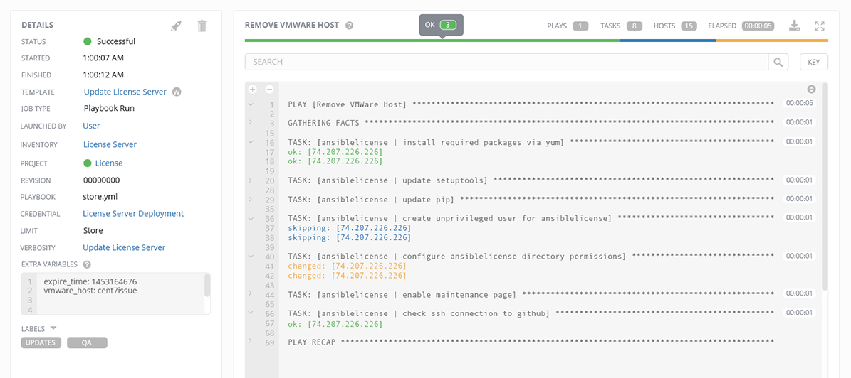
Ansible Tower
Job Status Update
Heads-up NOC-style automation dashboard displays everything going on in your Ansible environment.
1
Notes:
1

Slide 23
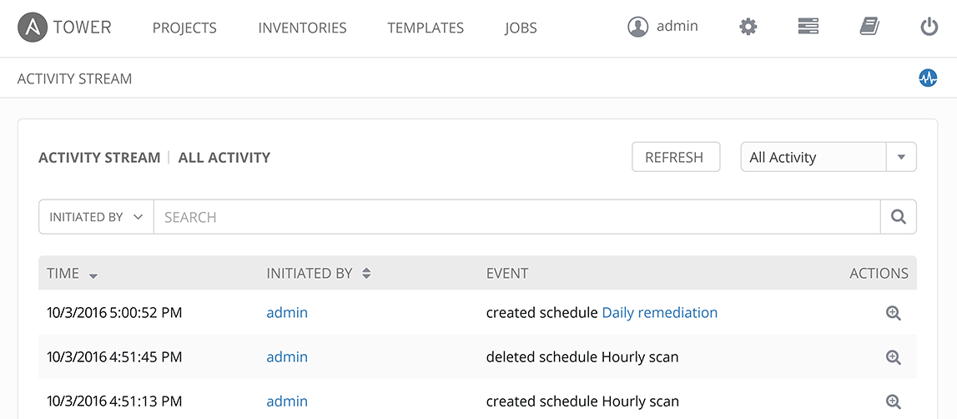
Ansible Tower
Activity Stream
Securely stores every Job that runs, and enables you to view them later, or export details through Tower’s API.
1
Notes:
1

Slide 24
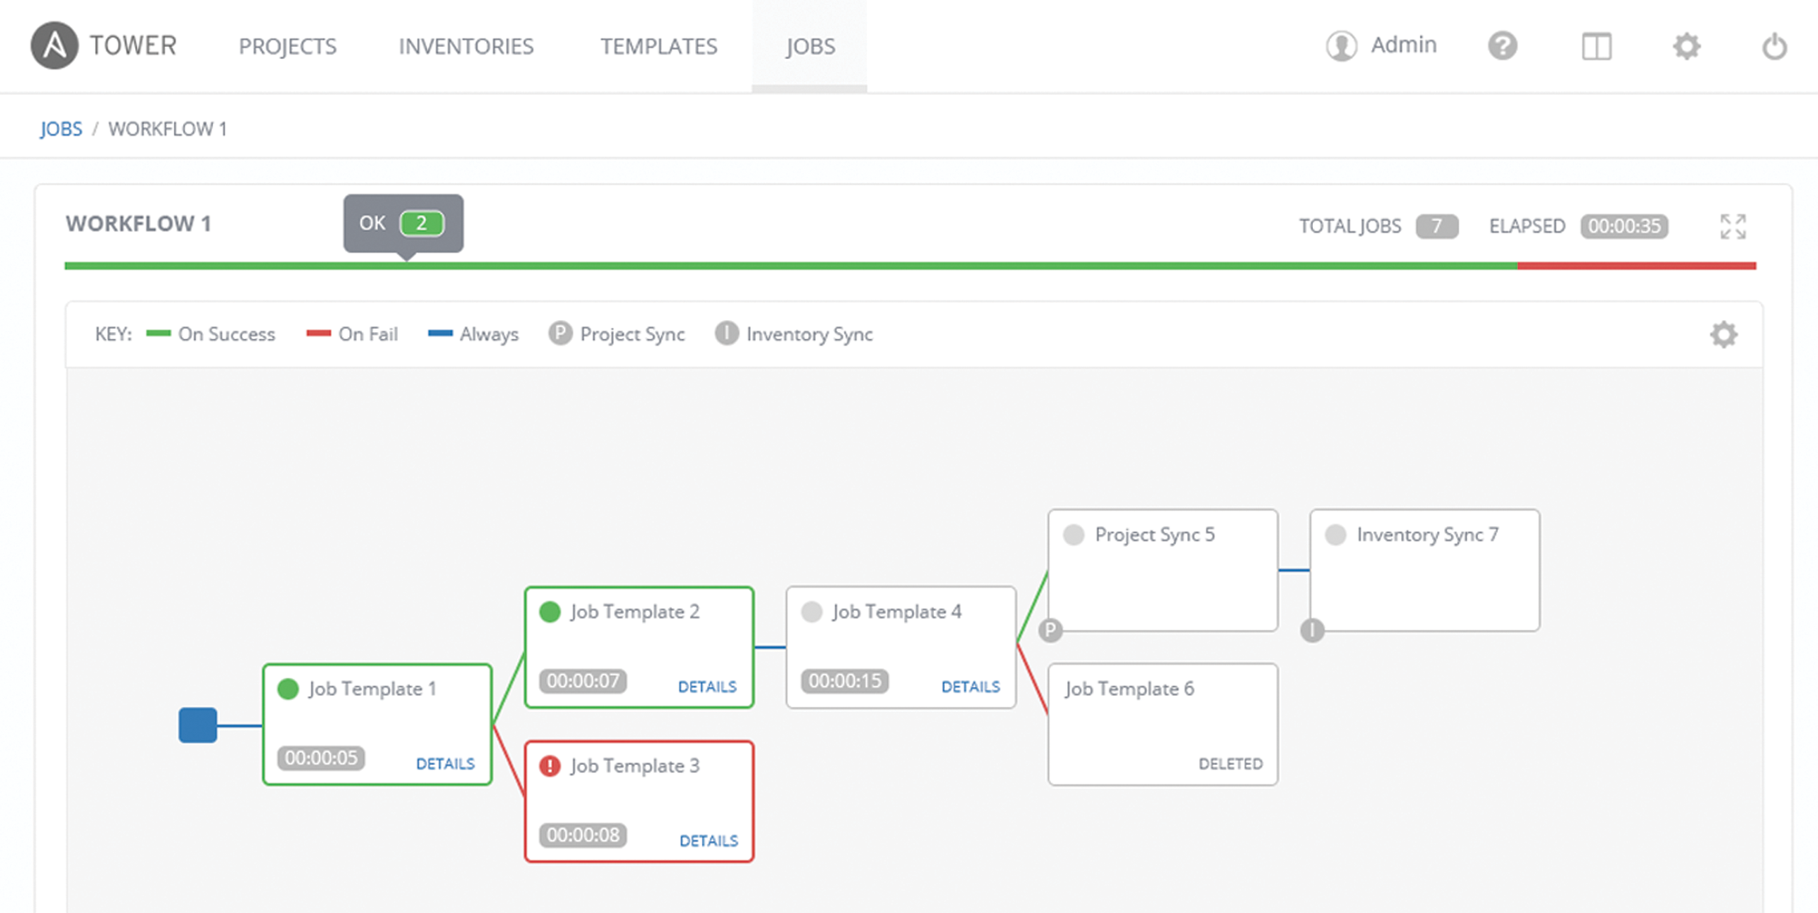
Ansible Tower
Multi-Playbook Workflows
Tower’s multi-Playbook workflows chains any number of Playbooks together to create a single workflow. Different Jobs can be run depending on success or failure of the prior Playbook.
1
Notes:
1

Slide 25
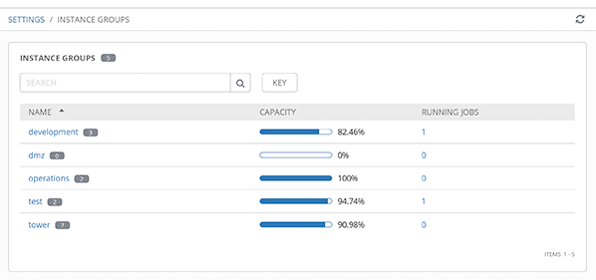
Ansible Tower
Scale-Out Clustering
Connect multiple Tower nodes into a Tower cluster to add redundancy and capacity to your automation platform.
Add reserved capacity and capacity by organization, and deploy remote execution nodes for additional local capacity.
1
Notes:
<number>

Slide 26
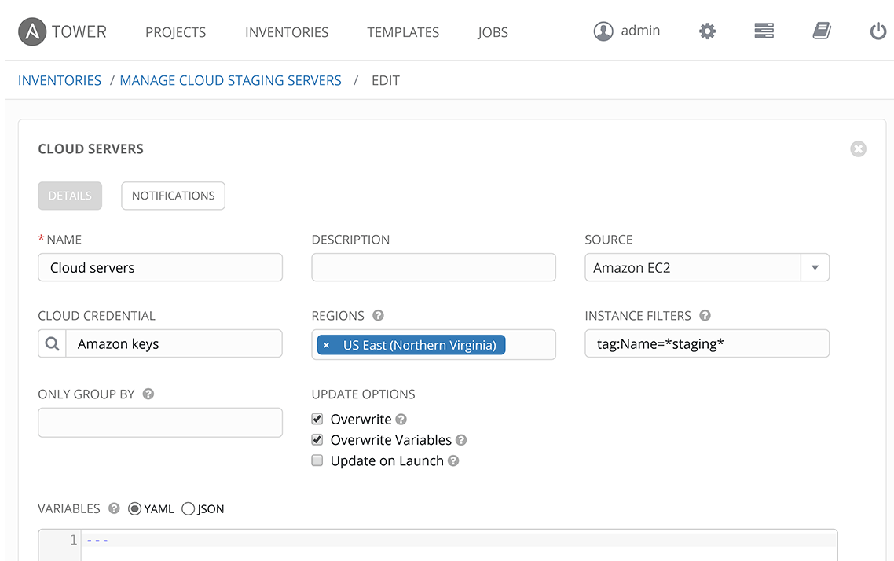
Ansible Tower
Manage and Track Your Inventory
Tower’s inventory syncing and provisioning callbacks allow nodes to request configuration on demand, enabling autoscaling.
Smart Inventories allow you to organize and automate hosts across all your providers based on a powerful host fact query engine.
See alerts from Red Hat Insights directly from Tower, and use Insights-provided Playbook Remediation to fix issues in your infrastructure.
1
Notes:
<number>

Slide 27
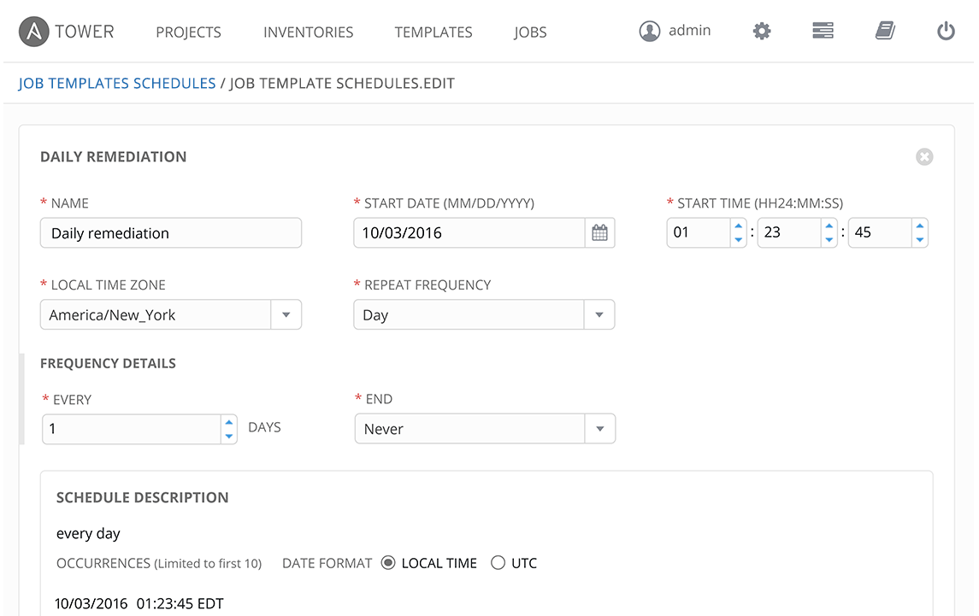
Ansible Tower
Schedule Jobs
Enables you to schedule any Job now, later, or forever.
1
Notes:
<number>

Slide 28
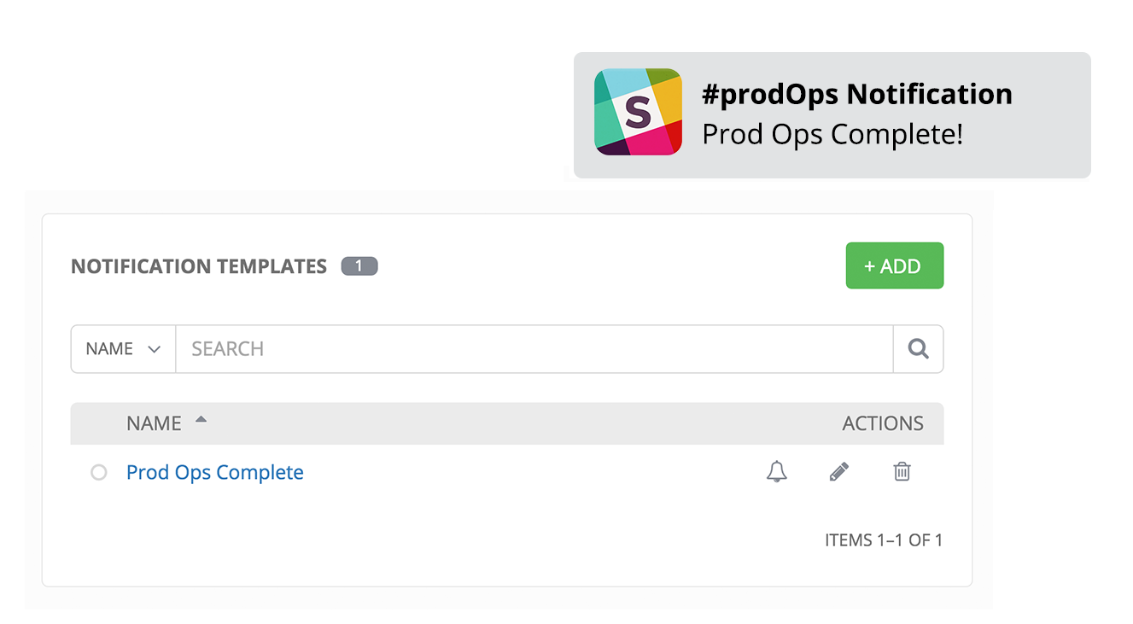
Ansible Tower
Integrated Notifications
Stay informed of your automation status via integrated notifications. Connect Slack, Hipchat, SMS, email and more.
1
Notes:
<number>

Slide 29
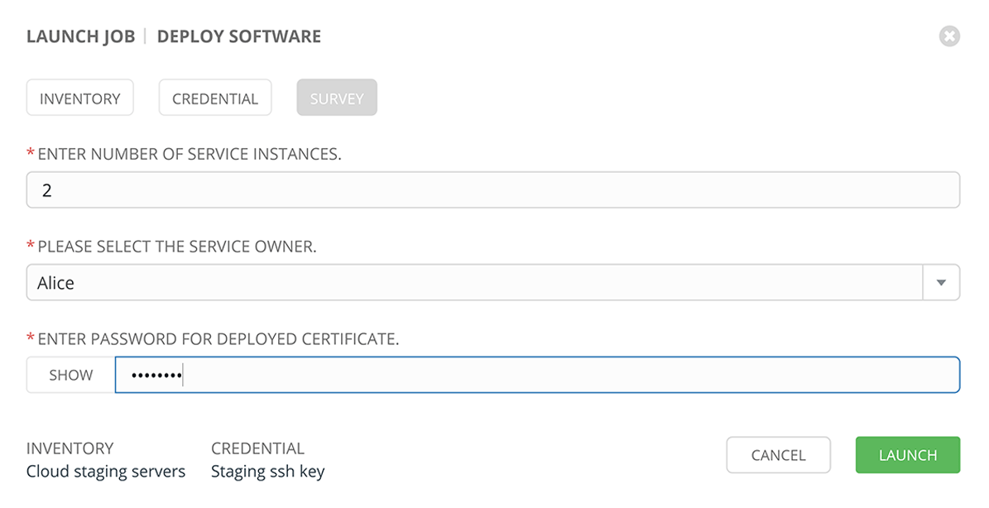
Ansible Tower
Self-Service IT
Tower lets you launch Playbooks with just a single click. It can prompt you for variables, let you choose from available secure credentials and monitor the resulting deployments.
1
Notes:
<number>

Slide 30
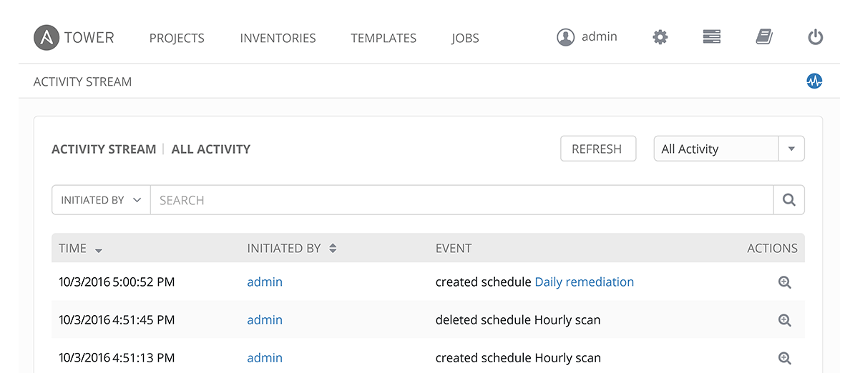
Ansible Tower
External Logging
Connect Tower to your external logging and analytics provider to perform analysis of automation and event correlation across your entire environment.
1
Notes:
<number>

Slide 31
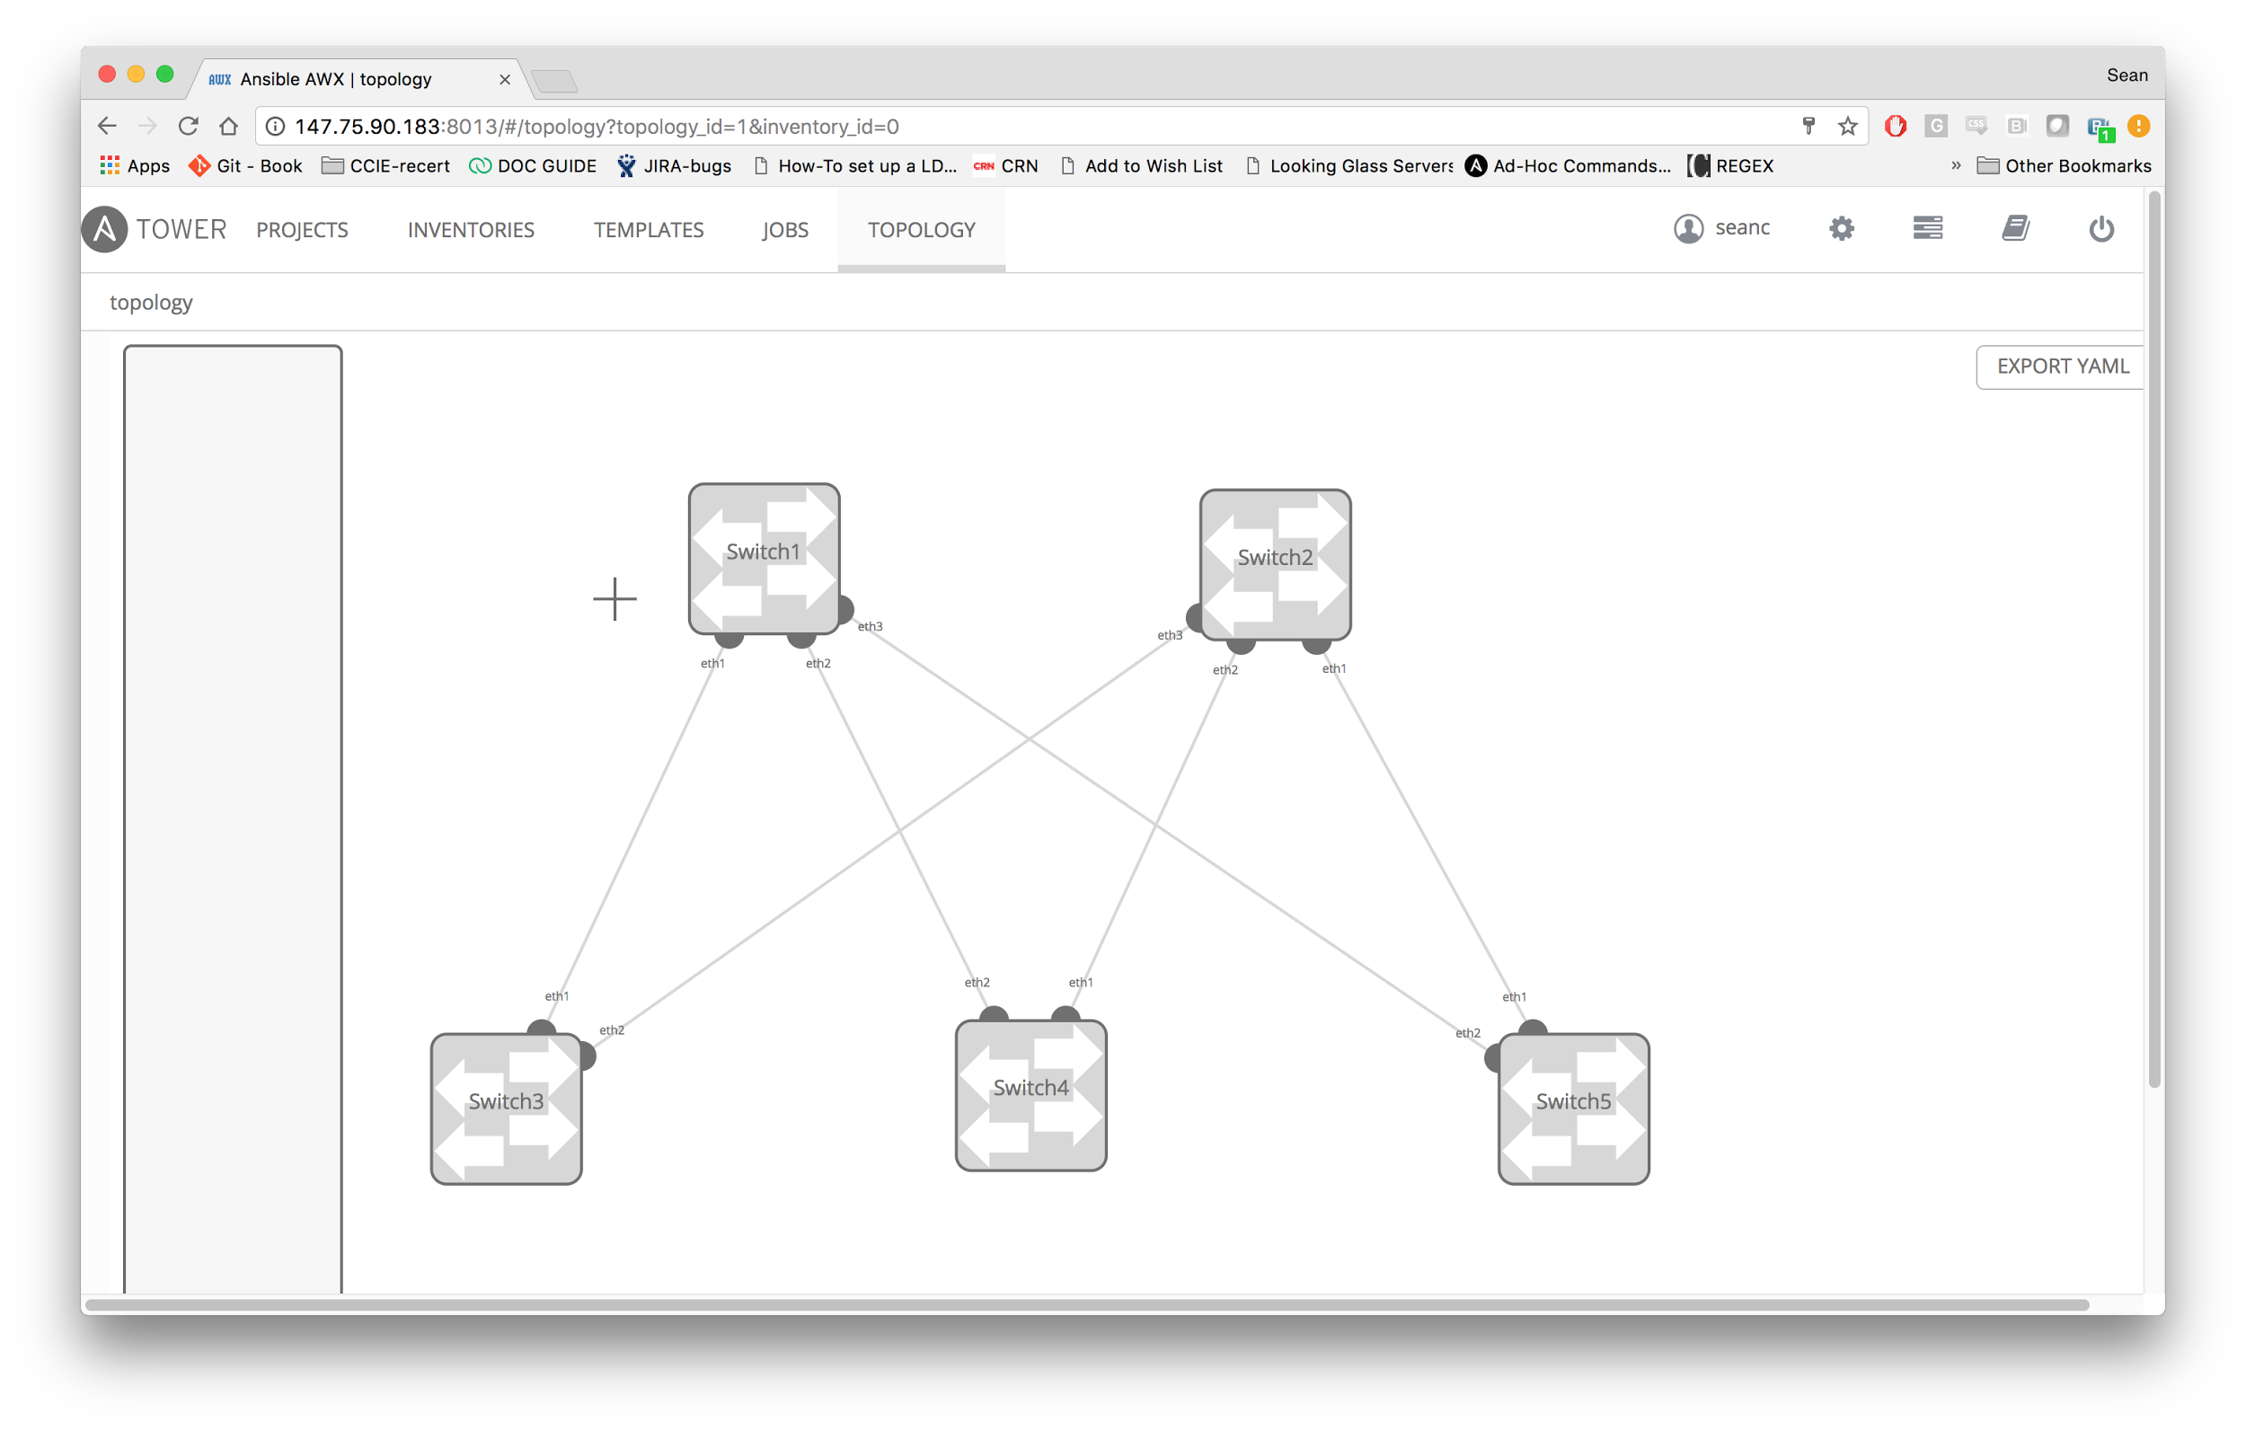
Ansible Tower
NOTE: Currently in Alpha and not committed to a release
Network Visualization
DISCOVER
Know what network devices and services are installed, represented visually
DESIGN
Create and build new topologies, adapt existing topologies from discovery, and utilize existing playbooks
DEPLOY
Convert designs to actual physical or virtual deployments using Ansible playbooks and network modules, and then automate deployment
Group, Copy/Paste, Zoom
1
Notes:
<number>

Slide 32


WHY ANSIBLE AUTOMATION?
Individual contributors or teams own their own automation and can make it executable as part of a workflow via Ansible Tower.
Provisioning Workflow
Provision VLAN
Provision VM
Linux Baseline Config
Install Oracle RAC
Patch System
Network Playbooks
Provisioning Playbooks
Configuration
Management Playbooks
Database Playbooks
Patching Playbooks
Network
Engineering
VMware
Engineering
System Engineering
Database Administration
System Administration

Slide 33
Use Cases
Notes:
<number>

Slide 34


Automating Complex Tasks
Automate the deployment of the individual components as a workflow.
Make that workflow available to operators.
Force changes to workflow to maintain compliance
Run that workflow on a regular bases to detect any deviation from the original deployment.
Routing/
Peering
Firewall Context
SVIs
VLANs
1
Notes:
<number>

Slide 35
Automating Troubleshooting
collect:
ios_router:
- show ip ospf neighbors....
- show bgp summary....
- show ip ospf route....
- show ip bgp route....
nxos_switch:
- show ip arp....
- show mac address-table....
bigip:
- ....
junos:
- ....
linux:
- ....

Slide 36

DC Fabric Deployment
interfaces:
vtep:
name: nve1
source_interface: loopback0
host_reachability: yes
control:
name: loopback0
address: "{{ control_plane_address }}"
fabric:
Ethernet1/1-4:
name: Ethernet1/1-4
FABRIC

Slide 37
Policy Abstraction
fw_rules:
- { rule: "public", src_ip: 0.0.0.0/0, dst_ip: 192.133.160.23/32, dst_port: 32400, proto: tcp, action: allow, comment: app1 }
- { rule: "public", src_ip: 0.0.0.0/0, dst_ip: 192.133.160.23/32, dst_port: 1900, proto: udp, action: allow, comment: app2 }
- { rule: "public", src_ip: 0.0.0.0/0, dst_ip: 192.133.160.23/32, dst_port: 3005, proto: tcp, action: allow, comment: app3 }
- { rule: "public", src_ip: 0.0.0.0/0, dst_ip: 192.133.160.23/32, dst_port: 5353, proto: udp, action: allow, comment: app4 }
- name: Create security rules
panos_security_rule:
operation: "{{ item.action | default (omit) }}"
rule_name: "{{ item.comment | default (omit) }}"
service: "{{ item.dst_port | default (omit) }}"
description: "{{ item.description | default (omit) }}"
source_zone: "{{ item.rule | default (omit) }}"
destination_zone: "{{ item.destination_zone | default (omit) }}"
action: "{{ item.action | default ('allow') }}"
commit: "{{ item.comment | default (omit) }}"
- name: Insert ASA ACL
asa_config:
lines:
- "access-list {{ item.rule }} extended {{ item.action }}{{ item.proto }}{{ item.src_ip | ipaddr('network') }}{{ item.src_ip | ipaddr('network') }}{{ item.dst_ip | ipaddr('network') }}{{ item.dst_ip | ipaddr('network') }} eq {{ item.dst_port }}"
provider: "{{ cli }}"
with_items: "{{ fw_rules }}"
1
Notes:
<number>

Slide 38



Hybrid Cloud
VPC
Resource Group
Automate the creation of the VPC and network components.
Deploy the same routers, load-balancers, and firewalls that you use on-site.
Automate the entire network in a uniform way.
Host
Host
1
Notes:
<number>

Slide 39


Workflow Automation
Customer makes request from the service catalog
Request goes through approval process
Service catalog calls Tower API to fulfill request
Ansible Tower updates ticket
Network
1
Notes:
<number>

Slide 40



Tier 1 Support Automation
Monitoring/Logging Platform detects event and calls the Ansible Tower API
Ansible Tower runs a playbook to collect event-specific information
Ansible Tower runs a playbook to open a support ticket and/or notify Tier 2 support
Send Notification/
Open Ticket
Collect Data
Network
1
Notes:
<number>

Slide 41
Demos
Ansible servers -m ping
ansible servers -m copy -a "src=/etc/yum.conf dest=/tmp/yum.conf" -u devops
ansible servers -m fetch -a "src=/etc/yum.conf dest=/tmp/yum.conf" -u devops
ansible servers -m file -a "dest=/etc/yum.conf
ansible servers -m yum -a “name=apache state=present” -u devops -b
https://github.com/network-automation/
https://youtu.be/JhQqHoXvZP0

Slide 42
ad-hoc commands
ansible servers -m ping
ansible servers -m copy -a "src=/etc/yum.conf dest=/tmp/yum.conf" -u devops
ansible servers -m fetch -a "src=/etc/yum.conf dest=/tmp/yum.conf" -u devops
ansible servers -m file -a "dest=/etc/yum.conf
ansible servers -m yum -a “name=apache state=present” -u devops -b
https://github.com/network-automation/
ansible-doc
https://youtu.be/JhQqHoXvZP0

Slide 43
Virtualization Management
Start the virtual machines in KVM
Begin a workflow in Azure

Slide 44
Linux Host Modifications
Working through Logical Volume Management
Firewalls
Password updates
Log Files
https://youtu.be/JhQqHoXvZP0

Slide 45
Learning Environments
Network Automation Workshop Environment
Linux Automation Workshop Environment
https://asciinema.org/a/xQGRO6xvTlKiInTeqSx2ZKxho
https://youtu.be/JhQqHoXvZP0

Slide 46
GETTING STARTED
Have you used Ansible already? Try Tower for free: ansible.com/tower-trial
Would you like to learn Ansible? It’s easy to get started: ansible.com/get-started
Want to learn more?
Videos, webinars, case studies, whitepapers: ansible.com/resources

Slide 47
Training Resources
Ansible Networking Automation HQ:
DO-407 Automation with Ansible
DO-409 Automation with Ansible II, Ansible Tower
DO-457 Ansible for Network Automation

Slide 48
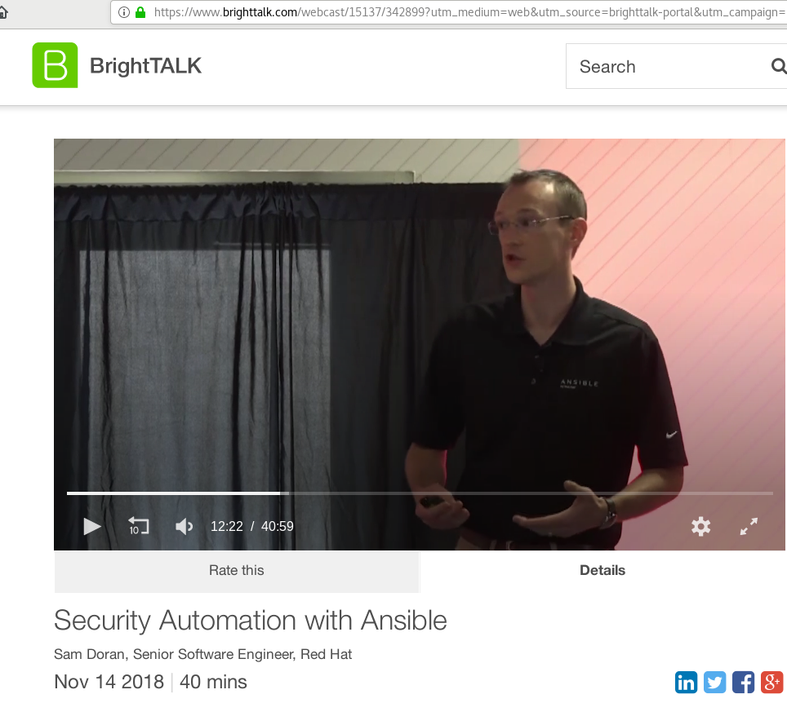
BrightTALK Sessions, Nov 14 2018

Slide 49
Additional Learning Resources
Ansible Networking Automation HQ: https://github.com/network-automation/
AWS Demo Environment provisioning: https://github.com/network-automation/linklight
Ansible Galaxy, roles for downloading: https://galaxy.ansible.com
“Official” Great sample playbooks for best practices https://github.com/ansible/ansible-examples
Ansible Security Project: https://github.com/ansible/ansible-lockdown

Slide 50
Credits
https://www.tutorialspoint.com/ansible/ansible_ad_hoc_commands.htm
Sam Doran:
https://github.com/samdoran

Slide 51

Questions?

